Slide 1


研究テーマ発表
9LDI1101
Siwon Seo

Slide 2
Multi-Task Learning of Generation and Classification for Emotion-Aware Dialogue Response Generation
Tatsuya Ide and Daisuke Kawahara Waseda University (25 May 2021)
the purpose of our multi-task learning method is to improve the quality of response generation, not to improve the performance of emotion recognition. This is different from general multitask learning.
反応生成の品質向上。

Slide 3
An Analysis of Annotated Corpora for Emotion Classification in Text
[An Analysis of Annotated Corpora for Emotion Classification in Text](https://aclanthology.org/C18-1179) (Bostan & Klinger, COLING 2018)
Sven Buechel and Udo Hahn. 2017. EmoBank: Studying the Impact of Annotation Perspective and Representation Format on Dimensional Emotion Analysis. In EACL 2017 - Proceedings of the 15th Conference of the European Chapter of the Association for Computational Linguistics. Valencia, Spain, April 3-7, 2017. Volume 2, Short Papers, pages 578-585. Available: http://aclweb.org/anthology/E17-2092
Sven Buechel and Udo Hahn. 2017. Readers vs. writers vs. texts: Coping with different perspectives of text understanding in emotion annotation. In LAW 2017 - Proceedings of the 11th Linguistic Annotation Workshop @ EACL 2017. Valencia, Spain, April 3, 2017, pages 1-12. Available: https://sigann.github.io/LAW-XI-2017/papers/LAW01.pdf

Slide 4
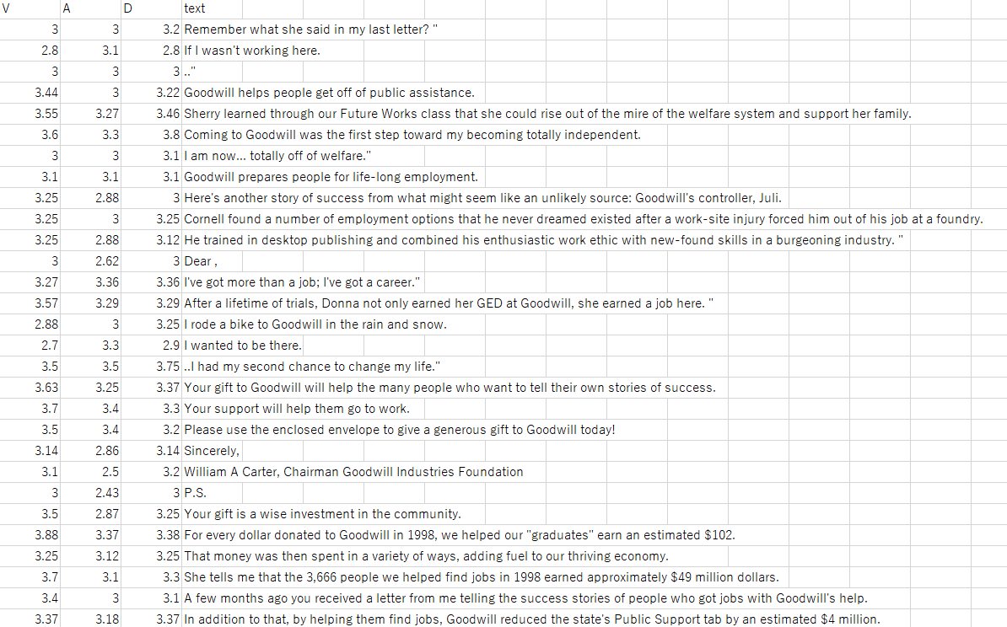
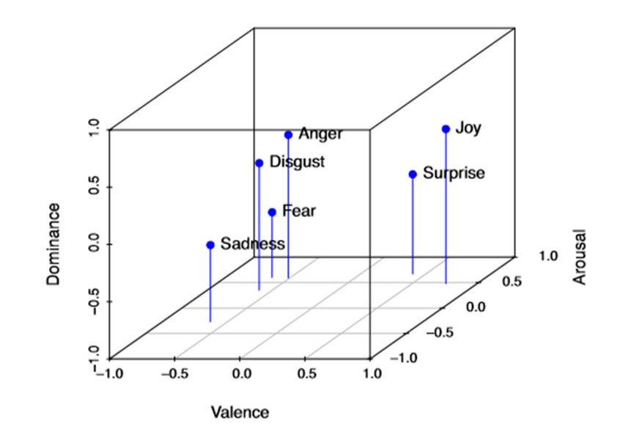
EmoBank

Slide 5
Emotional Tweets
[#Emotional Tweets](https://aclanthology.org/S12-1033) (Mohammad, SemEval-*SEM 2012)
anger, disgust, fear, joy, sadness, surprise で分類されてるデータセットを利用した研究。

